Slide 1
ACOUSTIC ECHO CANCELLER
TERM PAPER

Slide 2
ABSTRACT
Today people are more interested in hands-free communication with developing technologies.
In such a situation, the use a regular loudspeaker and a high-gain microphone, in place of a telephone receiver, seems more appropriate.
For example, in case of teleconferencing the presence of a large acoustic coupling between the loudspeaker and microphone would produce a loud echo that would make conversation difficult. Furthermore, the acoustic system could become instable, which would produce a loud howling noise to occur.
The solution to these problems is the elimination of the echo with an echo suppression or echo cancellation algorithm.

Slide 3
BASIC COMPONENTS OF ACOUSTIC ECHO CANCELLER
The three basic components of an echo canceller are an adaptive filter, a doubletalk detector and a nonlinear processor.
The adaptive filter creates a replica of the echo and subtracts it from the combination of the actual echo and the near-end signal.
The doubletalk detector senses the doubletalk. Doubletalk occurs when both ends are talking, which stops the adaptive filter in order to avoid divergence.
The nonlinear processor removes the residual echo from the error signal.

Slide 4
INTRODUCTION
Today’s subscribers use speech quality as a standard for assessing the overall quality of a network.
The effective removal of hybrid and acoustic echoes, which are inherent within the telecommunications network infrastructure, is the key to maintaining and improving the perceived voice quality of a call.
A definition of echo precedes the discussion of the fundamentals of echo cancellation and the voice quality challenges encountered in today’s networks.

Slide 5
BASICS OF ECHO
Echo is a phenomenon where a delayed and distorted version of an original sound or electrical signal is reflected back to the source.
The most important factor in echoes is called end-to-end delay, which is also known as latency. Latency is the time between the generation of the sound at one end of the call and its reception at the other end.
Round trip delay, which is the time taken to reflect an echo, is approximately twice the end-to-end delay.
Echoes become annoying when the round trip delay exceeds 30 ms. Such an echo is typically heard as a hollow sound.

Slide 6
TYPES OF ECHO
In telecommunications networks there are two types of echo.
One source for an echo is electrical or hybrid and the other echo source is acoustic.
The development of hands-free teleconferencing systems gave rise to another kind of echo known as an acoustic echo.
The acoustic echo is due to the coupling between the loudspeaker and microphone.

Slide 7
THE PROCESS OF ECHO CANCELLATION
An echo canceller is basically a device that detects and removes the echo of the signal from the far end after it has echoed on the local end’s equipment.
An echo canceller consists of three main functional components:
• Adaptive filter
• Doubletalk detector
• Non-linear processor

Slide 8
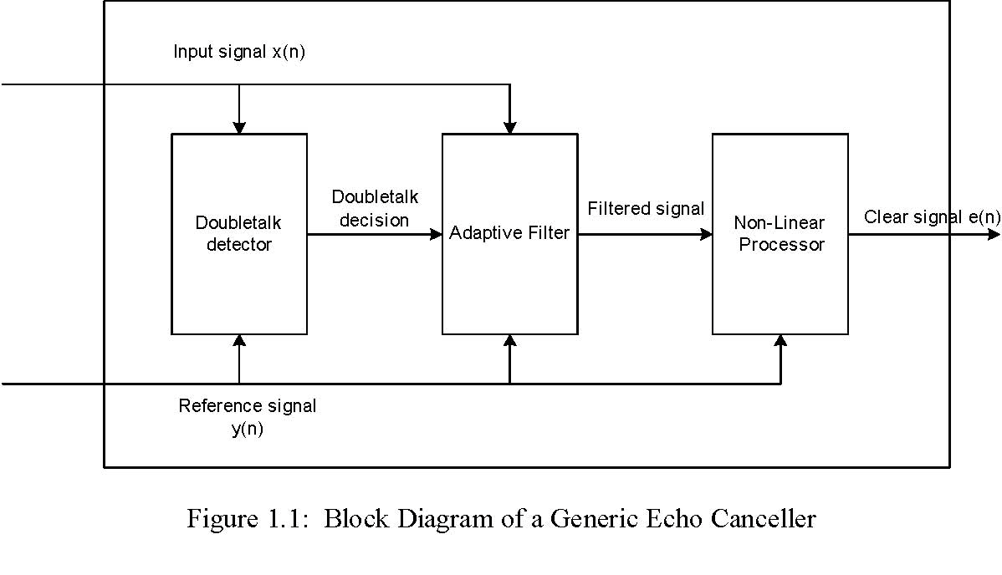
BLOCK DIAGRAM

Slide 9
HYBRID / ELECTRICAL ECHO
Hybrid echoes have been inherent within the telecommunications networks since the advent of the telephone.
In the Public Switched Telephone Network, (PSTN), by far the main source of electrical echo is the hybrid.
The impedance mismatch between the two-wire loop and the four-wire facility causes a small part of the received signal to “leak” back onto the transmission path.
The electrical echo must be controlled on long distance calls.

Slide 10
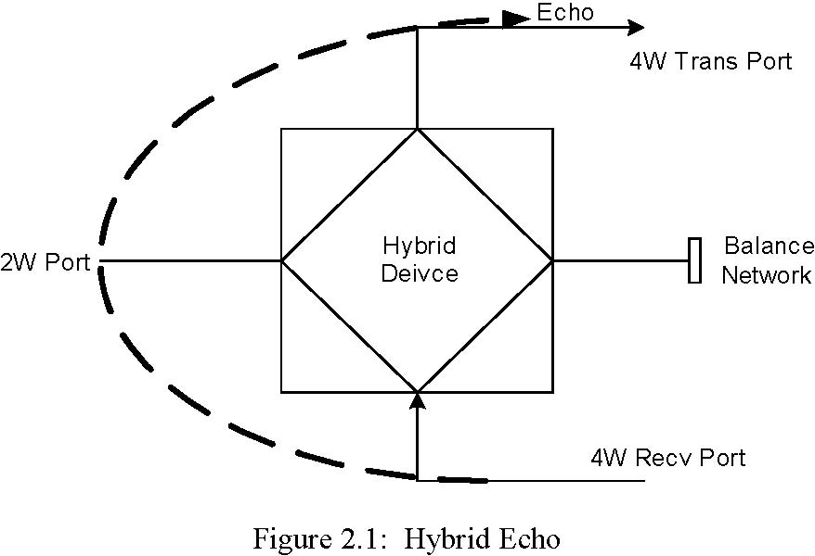
HYBRID ECHO DIAGRAM

Slide 11
ACOUSTIC ECHO
The acoustic echo, which is also known as a “multipath echo”, is produced by poor voice coupling between the earpiece and microphone in handsets and hands-free devices.
Acoustic coupling is due to the reflection of the loudspeaker’s sound waves from walls, door, ceiling, windows and other objects back to the microphone.
Adaptive cancellation of various acoustic echoes has become very important in hands-free communication systems such as teleconference or videoconference systems.

Slide 12
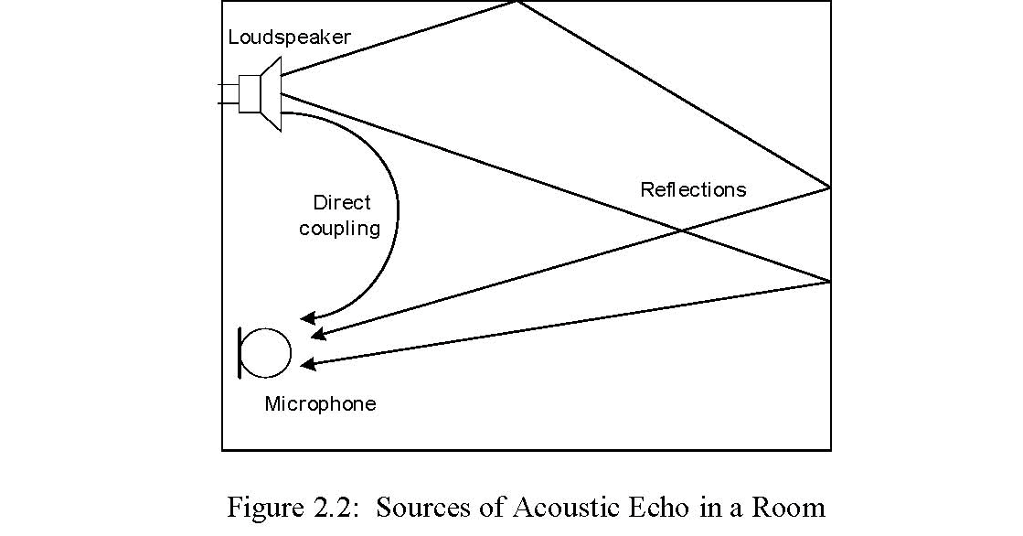
SOURCES OF ACOUSTIC ECHO IN A ROOM

Slide 13
ECHO SUPPRESSORS
Echo suppressors have been used since the introduction of long distance communication.
The situation of two people talking simultaneously is termed “double talking”.
The echo suppressor is also helped by the fact that during such double talking poor transmission quality is less noticeable.
The best solution for removing echoes is to use echo cancellers.

Slide 14
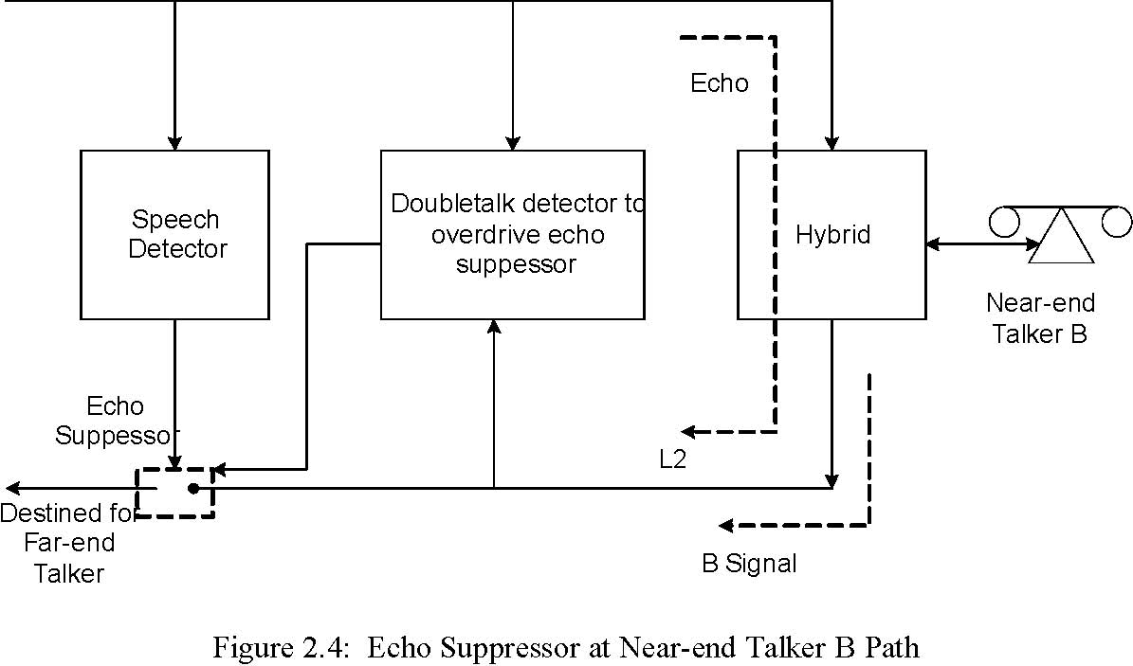
ECHO SUPPRESSOR BLOCK DIAGRAM

Slide 15
TELECONFERENCE/ VIDEOCONFERENCE COMMUNICATION SYSTEMS
When the telephone connection is between hands-free telephones or between two conference rooms, then an acoustic echo problem emerges that is due to the reflection of the loudspeaker’s sound waves from the boundary surfaces and other objects back to the microphone.
This acoustic echo can be removed using an adaptive filter.

Slide 16
ADAPTIVE FILTER
Adaptive acoustic echo cancellation is a more challenging problem than the network echo cancellation.
The characteristics of the acoustic echo path are more non-stationary due to opening and closing of a door or movement of people inside the room while the network echo path is almost stationary.
The acoustic echo path has a mixture of linear and nonlinear characteristics.
The reflection of acoustic signals inside a room is almost linearly distorted.
However, the loudspeaker does introduce nonlinearity.
The acoustic echo cancellers, (AECs), are required to have more computing power in order to compensate for the longer impulse response and to produce faster converging algorithms.

Slide 17
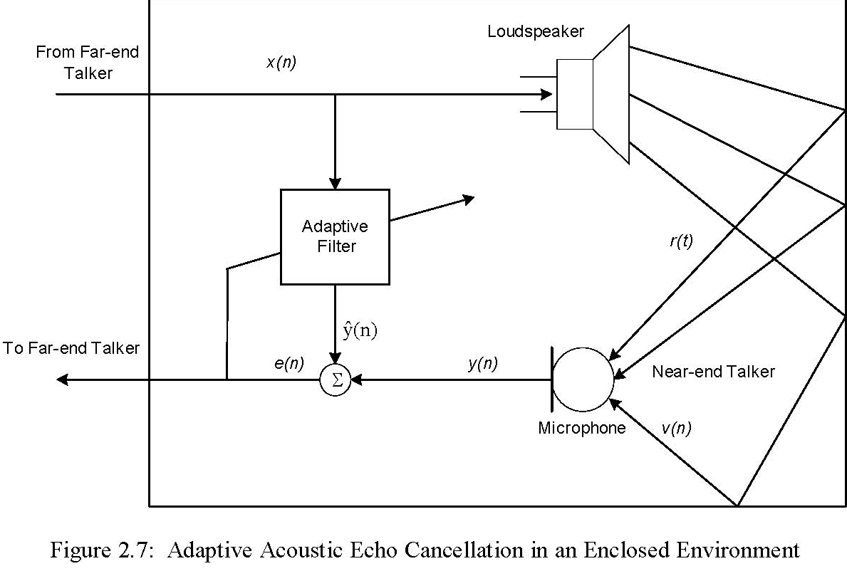
ADAPTIVE ACOUSTIC ECHO CANCELLATION

Slide 18
BASIC ECHO CANCELLER
The echo canceller mimics the transfer function of the echo path in order to synthesize a replica of the echo.
Adaptive echo cancellers also face the problem of double talking when both near and far end speakers talk simultaneously.
If double talk occurs, the system may try to adjust the adaptive filter parameters to imperfectly cancel the near-end talker signal.
The design of a good double talking detector is difficult.
Even with the assumption of a fast-acting detector, there is still a possibility of changes occurring in the echo channel during the time that the echo canceller is not updated, which leads to increasing amount of uncancelled echoes.

Slide 19
COMPONENTS OF AN ACOUSTIC ECHO CANCELLER (AEC)
The three fundamental components that combine to form an echo canceller are:
1. Adaptive Filter
2. Doubletalk Detector
3. Nonlinear Processor

Slide 20
ADAPTIVE FILTERING AND LMS ALGORITHM
Filtering is a signal processing technique whose objective is to process a signal in order to manipulate the information contained in the signal.
A filter is a device that maps its input signal into another output signal by extracting only the desired information contained in the input signal.
The main features that attracted the use of the LMS algorithm are low computational complexity, proof of convergence in stationary environments and stable behavior when implemented with finite precision arithmetic.
The task of the LMS algorithm is to estimate the transfer function of the filter.

Slide 21
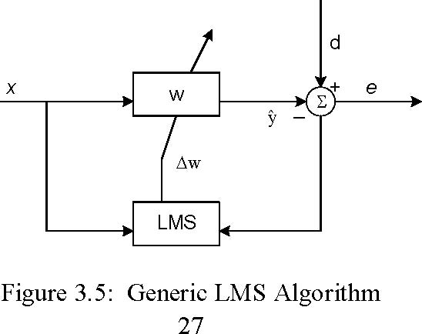
GENERIC LMS ALGORITHM

Slide 22
NON LINEAR PROCESSOR
A nonlinear processor, (NLP), is a signal processing circuit or algorithm that is placed in the speech path after echo cancellation in order to provide further attenuation or removal of residual echo signals that cannot be removed completely by an echo canceller.
A non-linearity, a distortion, or an added noise signal are examples of signals that cannot be fully cancelled by an echo canceller.
Therefore, these signals are typically removed or attenuated by a nonlinear processor.

Slide 23
NOISE GATE AS NLP
Noise gates belong to the family of expanders.
It increases the dynamic range of a signal such that low-level signals are attenuated while the higher-level portions are neither attenuated nor amplified.
The expander acts like an on/off switch for signals. When the signal is high enough, the switch is on and the input appears at the output.
However, when the signal drops below the threshold the switch is off and there is no output.

Slide 24
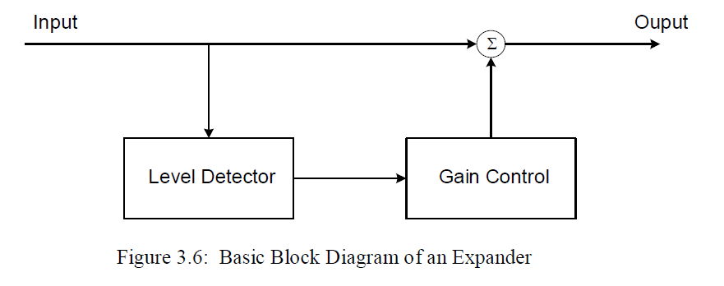
BLOCK DIAGRAM OF AN EXPANDER

Slide 25
CONCLUSIONS
The Echo cancellation algorithm presented in this presentation successfully attempted to find a software solution for the problem of echoes in the telecommunications environment.
The proposed algorithm was completely a software approach without utilizing any DSP hardware components.
Additionally, a new method, which utilized the noise gate device for nonlinear processing was proposed.
This new technique is faster and provides almost perfect results for canceling residual echoes without clipping of the reference speech signals.

Slide 26
FURTHER WORKS
The algorithm proposed in this paper presents a solution for single channel acoustic echoes. However, most often in real life situations, multichannel sound is the norm for telecommunication.
For example, when there is a group of people in a teleconference environment and everybody is busy talking, laughing or just communicating with each other multichannel sound abounds. Since there is just a single microphone the other end will hear just a highly incoherent monographic sound. In order to handle such situations in a better way the echo cancellation algorithm developed during the research should be extended for the multichannel case.

Slide 27
SUBMITTED BY :
Neha Goyal (Y09UC255)
Sumit Gautam (Y09UC285)

